Slide 1
Data Visualization
Nouman M Durrani

Slide 2

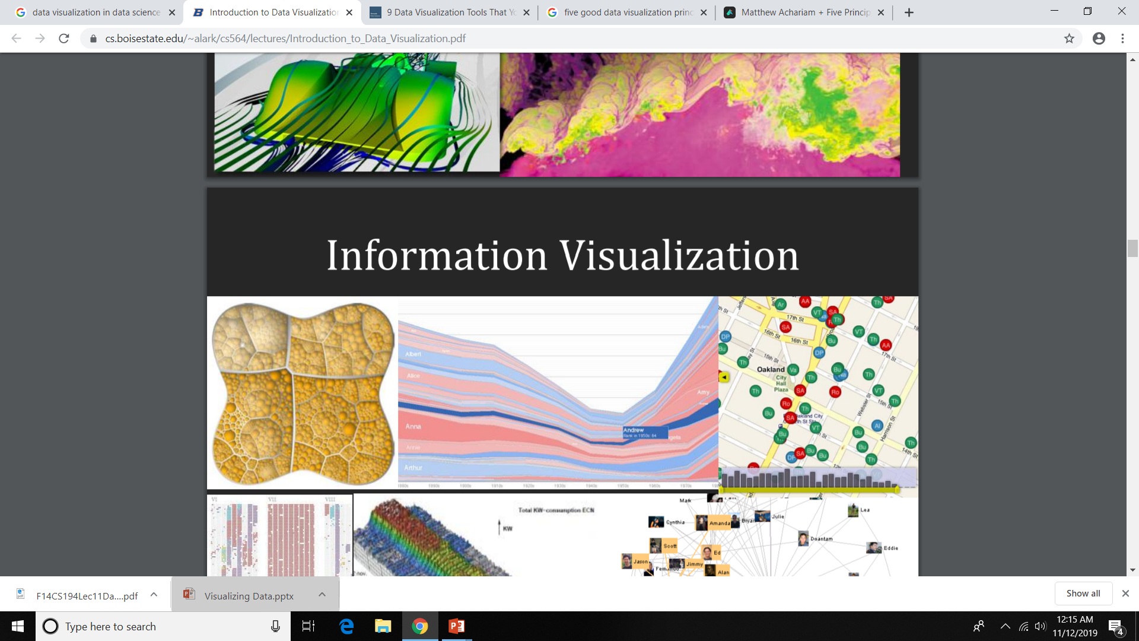
Data visualization
Sometimes data does not make sense until you can look at in a visual form, such as with charts and plots.
Data visualization is all about understanding data by placing it in a visual context so that patterns, trends and correlations can be exposed that might not otherwise be detected.
Data visualization is visual representation of data for exploration, discovery, and insight of data.
Interactive component provides more insight as compared to a static image.

Slide 3
Types of Data Visualization
Scientific visualization, information visualization, and visual analytics are the three main branches of visualization.
Scientific Visualization
– Structural Data – Seismic, Medical, ..
Information Visualization
– No inherent structure – News, stock market, top grossing movies, Facebook connections
Visual Analytics
– Use visualization to understand and synthesize large amounts of multimodal data – audio, video, text, images, networks of people ..

Slide 4
Line Graphs in Matplotlib
Matplotlib is a Python library used to create charts and graphs
The concepts you will learn include:
Creating a line graph from data
Changing the appearance of the line
Zooming in on different parts of the axis
Putting labels on titles and axes
Creating a more complex figure layout
Adding legends to graphs
Changing tick labels and positions
Before we start working with Matplotlib, we need to import it into our Python environment
from matplotlib import pyplot as plt

Slide 5
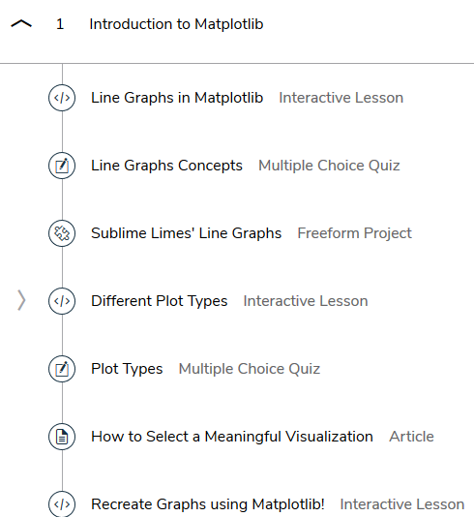
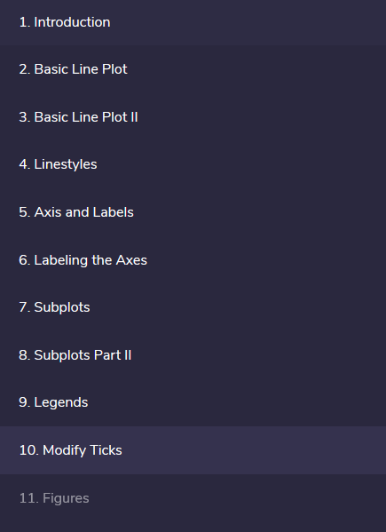

Slide 6
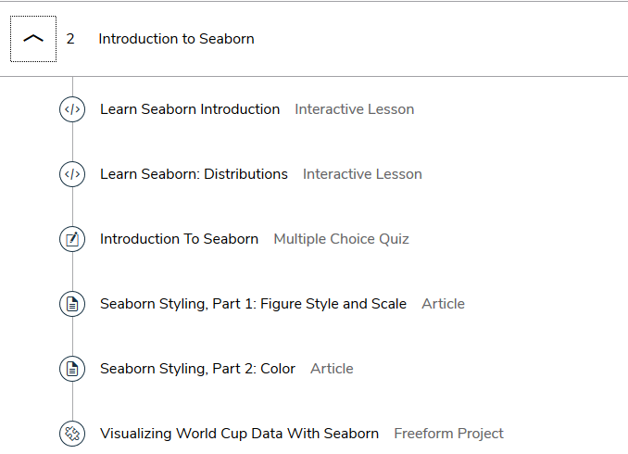

Slide 7
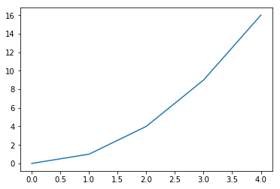
Line Graphs in Matplotlib
Basic Line Plot:
Line graphs are helpful for visualizing how a variable changes over time.
Some possible data that would be displayed with a line graph:
average prices of gasoline over the past decade
weight of an individual over the past couple of months
average temperature along a line of longitude over different latitudes
Using Matplotlib methods, the following code will create a simple line graph using .plot() and display it using .show():
x_values = [0, 1, 2, 3, 4]
y_values = [0, 1, 4, 9, 16]
plt.plot(x_values, y_values)
plt.show()
# plt.plot(x_values, y_values) will create the line graph

Slide 8
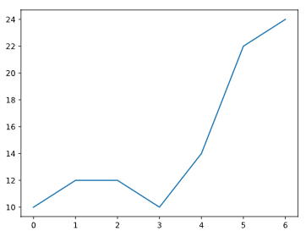
Line Graphs in Matplotlib
Example: We are going to make a simple graph representing someone’s spending on lunch over the past week.
First, define two lists, days and money_spent, that contain the following integers:
Days | Money Spent
0 | 10
1 | 12
2 | 12
3 | 10
4 | 14
5 | 22
6 | 24
from matplotlib import pyplot as plt
days = range(7) # days = [0, 1, 2, 3, 4,5, 6]
money_spent = [10, 12, 12, 10, 14, 22, 24]
plt.plot(days, money_spent)
plt.show()
Plot days on the x-axis and money_spent on the y-axis using plt.plot().

Slide 9
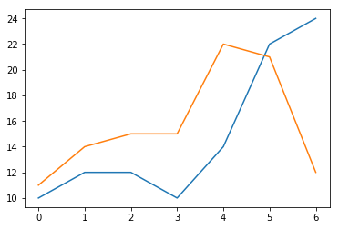
Multiple Line Graphs in Matplotlib
We can also have multiple line plots displayed on the same set of axes.
This can be very useful if we want to compare two datasets with the same scale and axis categories
Matplotlib will automatically place the two lines on the same axes and give them different colors if you call plt.plot() twice
# Days of the week:
days = [0, 1, 2, 3, 4, 5, 6]
# Your Money:
money_spent = [10, 12, 12, 10, 14, 22, 24]
# Your Friend's Money:
money_spent_2 = [11, 14, 15, 15, 22, 21, 12]
# Plot your money:
plt.plot(days, money_spent)
# Plot your friend's money:
plt.plot(days, money_spent_2)
# Display the result:
plt.show()

Slide 10
Multiple Line Graphs in Matplotlib
Lab Task 1:
We have defined lists called time, revenue, and costs.
time = [0, 1, 2, 3, 4]
revenue = [200, 400, 650, 800, 850]
costs = [150, 500, 550, 550, 560]
Plot revenue vs time.
Plot costs vs time on the same plot as the last line.

Slide 11
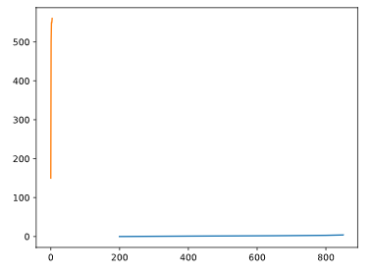
Multiple Line Graphs in Matplotlib
Solution:
from matplotlib import pyplot as plt
time = [0, 1, 2, 3, 4]
revenue = [200, 400, 650, 800, 850]
costs = [150, 500, 550, 550, 560]
# Plot your money:
plt.plot(revenue, time)
# Plot your friend's money:
plt.plot(time, costs)
# Display the result:
plt.show()

Slide 12
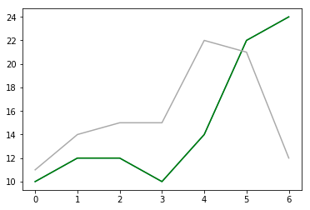
Line Graphs in Matplotlib: Linestyles
We can specify a different color for a line by using the keyword color with either an HTML color name or a HEX code
days = [0, 1, 2, 3, 4, 5, 6]
money_spent = [10, 12, 12, 10, 14, 22, 24]
money_spent_2 = [11, 14, 15, 15, 22, 21, 12]
plt.plot(days, money_spent, color='green')
plt.plot(days, money_spent_2, color='#AAAAAA')

Slide 13
Line Graphs in Matplotlib: Linestyles
We can also make a line dotted or dashed using the keyword linestyle.
# Dashed:
plt.plot(x_values, y_values, linestyle='--')
# Dotted:
plt.plot(x_values, y_values, linestyle=':')
# No line:
plt.plot(x_values, y_values, linestyle='')
We can also add a marker using the keyword marker:
# A circle:
plt.plot(x_values, y_values, marker='o')
# A square:
plt.plot(x_values, y_values, marker='s')
# A star:
plt.plot(x_values, y_values, marker='*')

Slide 14
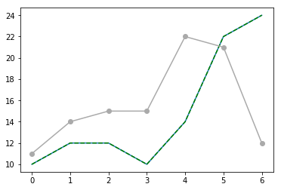
Line Graphs in Matplotlib: Linestyles
days = [0, 1, 2, 3, 4, 5, 6]
money_spent = [10, 12, 12, 10, 14, 22, 24]
money_spent_2 = [11, 14, 15, 15, 22, 21, 12]
plt.plot(days, money_spent, color='green', linestyle='--')
plt.plot(days, money_spent_2, color='#AAAAAA', marker='o')

Slide 15
Line Graphs in Matplotlib: Linestyles
Lab Task 2:
Plot revenue vs. time as a purple ('purple'), dashed ('--') line.
Plot costs vs. time as a line with the HEX color #82edc9 and square ('s') markers.

Slide 16
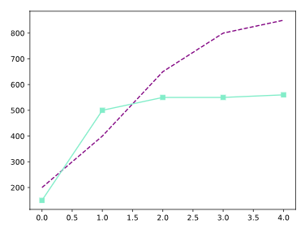
Line Graphs in Matplotlib: Linestyles
Solution:
from matplotlib import pyplot as plt
time = [0, 1, 2, 3, 4]
revenue = [200, 400, 650, 800, 850]
costs = [150, 500, 550, 550, 560]
plt.plot(time, revenue, color="purple", linestyle='--')
plt.plot(time, costs, color="#82edc9", marker='s')
plt.show()

Slide 17
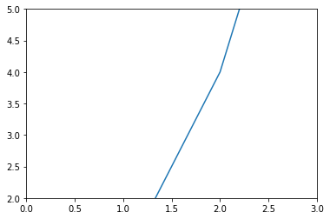
Line Graphs in Matplotlib: Axis and Labels
Sometimes, it can be helpful to zoom in or out of the plot, especially if there is some detail we want to address. To zoom, we can use plt.axis().
We use plt.axis() by feeding it a list as input. This list should contain:
The minimum x-value displayed
The maximum x-value displayed
The minimum y-value displayed
The maximum y-value displayed
x = [0, 1, 2, 3, 4]
y = [0, 1, 4, 9, 16]
plt.plot(x, y)
plt.axis([1, 3, 2, 5])
plt.show()
For example, if we want to display a plot from x=0 to x=3 and from y=2 to y=5, we would call plt.axis([0, 3, 2, 5]).

Slide 18
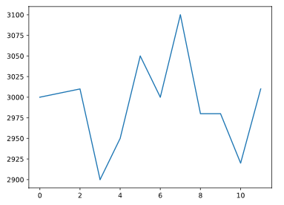
Line Graphs in Matplotlib
Lab Task 3:
We have plotted a line representing someone’s spending on coffee over the past 12 years.
Let’s modify the axes to zoom in a bit more on our line chart.
Use plt.axis() to modify the axes so that the x-axis goes from 0 to 12, and the y-axis goes from 2900 to 3100.
from matplotlib import pyplot as plt
x = range(12)
y = [3000, 3005, 3010, 2900, 2950, 3050, 3000, 3100, 2980, 2980, 2920, 3010]
plt.plot(x, y)
plt.axis([0, 12, 3000, 3010])
plt.show()

Slide 19
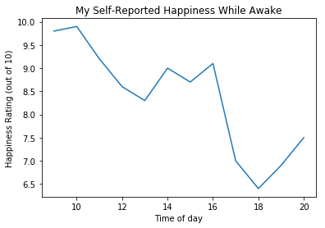
Line Graphs in Matplotlib: Labeling the Axes
Adding labels to the x-axis and y-axis, and giving the plot a title:
We can label the x- and y- axes by using plt.xlabel() and plt.ylabel()
The plot title can be set by using plt.title()
hours = [9, 10, 11, 12, 13, 14, 15, 16, 17, 18, 19, 20]
happiness = [9.8, 9.9, 9.2, 8.6, 8.3, 9.0, 8.7, 9.1, 7.0, 6.4, 6.9, 7.5]
plt.plot(hours, happiness)
plt.xlabel('Time of day')
plt.ylabel('Happiness Rating (out of 10)')
plt.title('My Self-Reported Happiness While Awake')
plt.show()

Slide 20
Line Graphs in Matplotlib: Labeling the Axes
Lab Task 4:
Consider the following code:
from matplotlib import pyplot as plt
x = range(12)
y = [3000, 3005, 3010, 2900, 2950, 3050, 3000, 3100, 2980, 2980, 2920, 3010]
Label the x-axis 'Time'.
Label the y-axis 'Dollars spent on coffee'.
Add the title 'My Last Twelve Years of Coffee Drinking'.

Slide 21
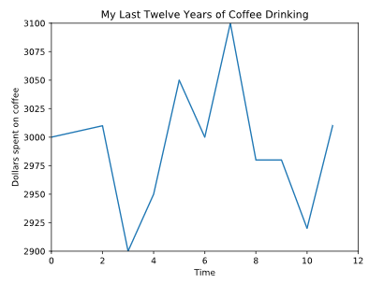
Line Graphs in Matplotlib: Labeling the Axes
Solution:
from matplotlib import pyplot as plt
x = range(12)
y = [3000, 3005, 3010, 2900, 2950, 3050, 3000, 3100, 2980, 2980, 2920, 3010]
plt.plot(x, y)
plt.axis([0, 12, 2900, 3100])
plt.xlabel('Time')
plt.ylabel('Dollars spent on coffee')
plt.title('My Last Twelve Years of Coffee Drinking')
plt.show()

Slide 22
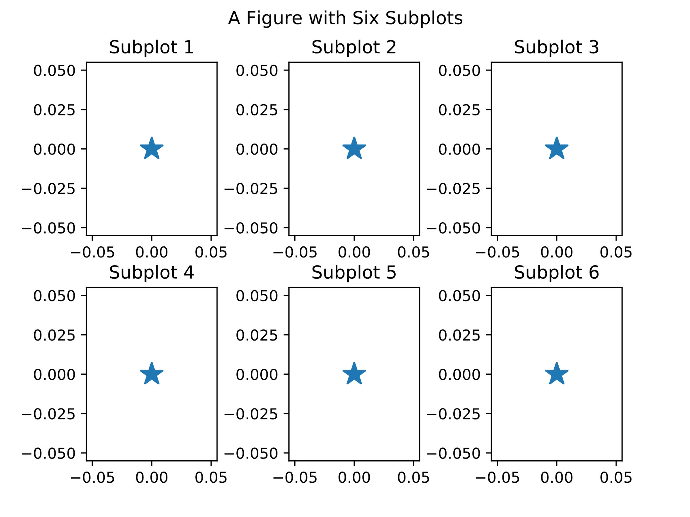
Line Graphs in Matplotlib: Subplots
Sometimes, we want to display two lines side-by-side, rather than in the same set of x- and y-axes.
When we have multiple axes in the same picture, we call each set of axes a subplot.
The picture or object that contains all of the subplots is called a figure.
This figure has six subplots split into 2 rows and 3 columns
We can create subplots using .subplot()

Slide 23
Line Graphs in Matplotlib: Subplots
The command plt.subplot() needs three arguments to be passed into it:
The number of rows of subplots
The number of columns of subplots
The index of the subplot we want to create
For instance, the command plt.subplot(2, 3, 2) would create “Subplot 2” from the figure above.
Any plt.plot() that comes after plt.subplot() will create a line plot in the specified subplot.

Slide 24
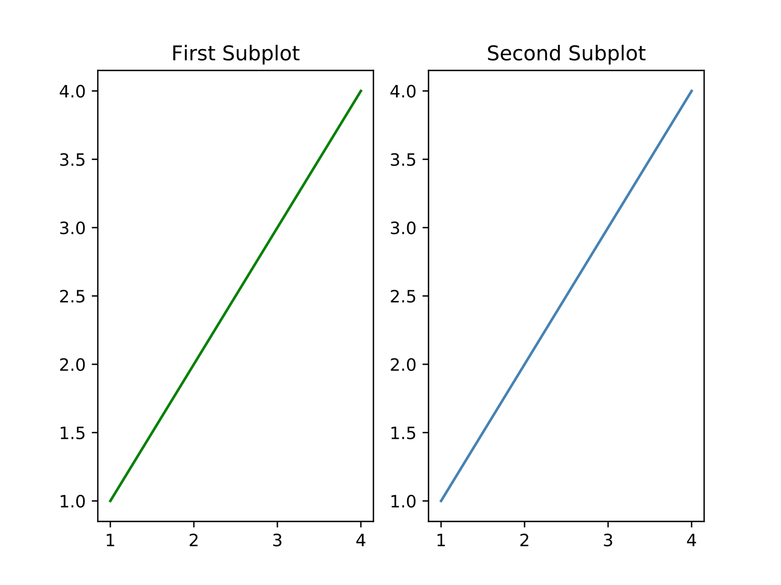
Line Graphs in Matplotlib : Subplots
# Data sets
x = [1, 2, 3, 4]
y = [1, 2, 3, 4]
# First Subplot
plt.subplot(1, 2, 1)
plt.plot(x, y, color='green')
plt.title('First Subplot')
# Second Subplot
plt.subplot(1, 2, 2)
plt.plot(x, y, color='steelblue')
plt.title('Second Subplot')
# Display both subplots
plt.show()

Slide 25
Line Graphs in Matplotlib: Subplots
Lab Task 5:
We have defined the lists months, temperature, and flights_to_hawaii for you.
Using the plt.subplot command, plot temperature vs months in the left box of a figure that has 1 row with 2 columns.
Plot flights_to_hawaii vs temperature in the same figure, to the right of your first plot.
Add the parameter "o" to the end of your call to plt.plot to make the plot into a scatterplot, if you want!
from matplotlib import pyplot as plt
months = range(12)
temperature = [36, 36, 39, 52, 61, 72, 77, 75, 68, 57, 48, 48]
flights_to_hawaii = [1200, 1300, 1100, 1450, 850, 750, 400, 450, 400, 860, 990, 1000]

Slide 26
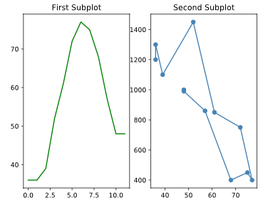
Line Graphs in Matplotlib: Subplots
Solution:
from matplotlib import pyplot as plt
months = range(12)
temperature = [36, 36, 39, 52, 61, 72, 77, 75, 68, 57, 48, 48]
flights_to_hawaii = [1200, 1300, 1100, 1450, 850, 750, 400, 450, 400, 860, 990, 1000]
plt.subplot(1, 2, 1)
plt.plot(months, temperature, color='green')
plt.title('First Subplot')
# Second Subplot
plt.subplot(1, 2, 2)
plt.plot(temperature, flights_to_hawaii, color='steelblue', marker='o')
plt.title('Second Subplot')
# Display both subplots
plt.show()

Slide 27
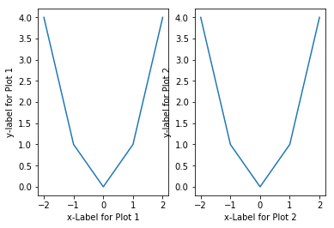
Line Graphs in Matplotlib: Subplots
Sometimes, when we’re putting multiple subplots together, some elements can overlap and make the figure unreadable:
We can customize the spacing between our subplots to make sure that the figure we create is visible and easy to understand
To do this, we use the plt.subplots_adjust() command

Slide 28
Line Graphs in Matplotlib: Subplots
.subplots_adjust() has some keyword arguments that can move your plots within the figure:
left — the left-side margin, with a default of 0.125. You can increase this number to make room for a y-axis label
right — the right-side margin, with a default of 0.9. You can increase this to make more room for the figure, or decrease it to make room for a legend
bottom — the bottom margin, with a default of 0.1. You can increase this to make room for tick mark labels or an x-axis label
top — the top margin, with a default of 0.9
wspace — the horizontal space between adjacent subplots, with a default of 0.2
hspace — the vertical space between adjacent subplots, with a default of 0.2

Slide 29
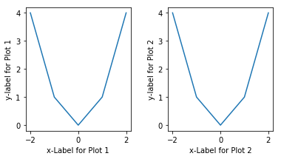
Line Graphs in Matplotlib: Subplots
For example:
if we were adding space to the bottom of a graph by changing the bottom margin to 0.2 (instead of the default of 0.1), we would use the command:
plt.subplots_adjust(bottom=0.2)
To adjust both the top and the hspace:
plt.subplots_adjust(top=0.95, hspace=0.25)
# Left Plot
plt.subplot(1, 2, 1)
plt.plot([-2, -1, 0, 1, 2], [4, 1, 0, 1, 4])
# Right Plot
plt.subplot(1, 2, 2)
plt.plot([-2, -1, 0, 1, 2], [4, 1, 0, 1, 4])
# Subplot Adjust
plt.subplots_adjust(wspace=0.35)
plt.show()

Slide 30
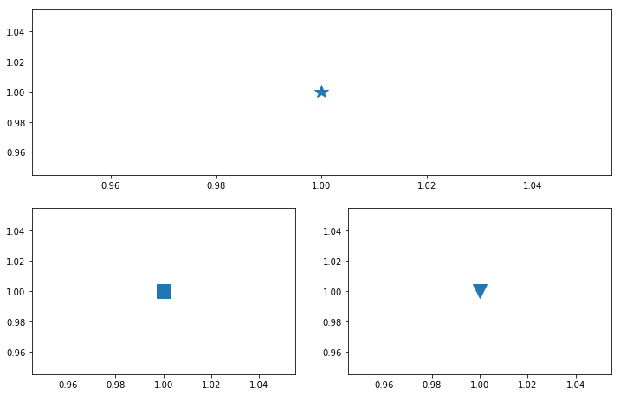
Line Graphs in Matplotlib: Subplots
Lab Task 6:
(a) Create a figure that has two rows of subplots. It should have:
one subplot in the top row
two subplots in the bottom row
(b) Plot straight_line vs x in this subplot you’ve selected.
Now, use the plt.subplot() command to select the box in the first column of the second row (the one with a square in it). Plot parabola vs x in this box.
(c) Now, use the plt.subplot() command to select the box in the second column of the second row (the one with a triangle in it). Plot cubic vs x in this box.
(d) Increase the spacing between horizontal subplots to 0.35 and the bottom margin to 0.2.

Slide 31
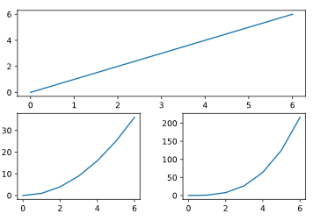
Line Graphs in Matplotlib
Solution:
from matplotlib import pyplot as plt
x = range(7)
straight_line = [0, 1, 2, 3, 4, 5, 6]
parabola = [0, 1, 4, 9, 16, 25, 36]
cubic = [0, 1, 8, 27, 64, 125, 216]
# Subplot 1
plt.subplot(2, 1, 1)
plt.plot(x, straight_line)
# Subplot 2
plt.subplot(2, 2, 3)
plt.plot(x, parabola)
# Subplot 3
plt.subplot(2, 2, 4)
plt.plot(x, cubic)
plt.subplots_adjust(wspace=0.35, bottom=0.2)
plt.show()

Slide 32
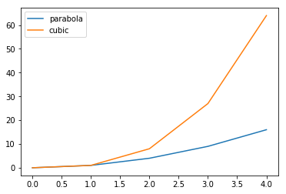
Line Graphs in Matplotlib: Legends
When we have multiple lines on a single graph we can label them by using the command plt.legend().
The legend method takes a list with the labels to display.
plt.plot([0, 1, 2, 3, 4], [0, 1, 4, 9, 16])
plt.plot([0, 1, 2, 3, 4], [0, 1, 8, 27, 64])
plt.legend(['parabola', 'cubic'])
plt.show()
which would display a legend on our graph, labeling each line:

Slide 33
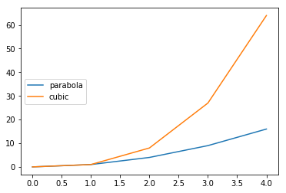
Line Graphs in Matplotlib: Legends
These are the position values loc accepts:
plt.legend() can also take a keyword argument loc, which will position the legend on the figure.
For, example, we can call plt.legend() and set loc to 6, which would move the legend to the left side of the graph:
plt.legend(['parabola', 'cubic'], loc=6)
plt.show()
Number Code | String
0 | best
1 | upper right
2 | upper left
3 | lower left
4 | lower right
5 | right
6 | center left
7 | center right
8 | lower center
9 | upper center
10 | center
Note: If you decide not to set a value for loc, it will default to choosing the “best” location.

Slide 34
Line Graphs in Matplotlib: Legends
Sometimes, it’s easier to label each line as we create it.
If we want, we can use the keyword label inside of plt.plot().
If we choose to do this, we don’t pass any labels into plt.legend().
For example:
plt.plot([0, 1, 2, 3, 4], [0, 1, 4, 9, 16], label="parabola")
plt.plot([0, 1, 2, 3, 4], [0, 1, 8, 27, 64], label="cubic")
plt.legend() # Still need this command!
plt.show()

Slide 35
Line Graphs in Matplotlib: Legends
Lab Task 6:
Consider the three plotted lines. They represent the temperatures over the past year in Hyrule (hyrule), Kakariko (kakariko), and the Gerudo Valley (gerudo).
Create a list of strings containing "Hyrule", "Kakariko", and "Gerudo Valley", and store it in a variable called legend_labels.
Create a legend for the graph by feeding in legend_labels into plt.legend().
Set the legend to be at the lower center of the chart.

Slide 36
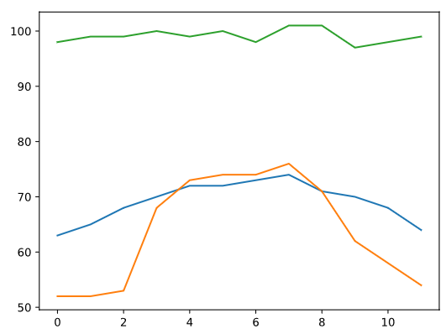
Line Graphs in Matplotlib: Legends
from matplotlib import pyplot as plt
months = range(12)
hyrule = [63, 65, 68, 70, 72, 72, 73, 74, 71, 70, 68, 64]
kakariko = [52, 52, 53, 68, 73, 74, 74, 76, 71, 62, 58, 54]
gerudo = [98, 99, 99, 100, 99, 100, 98, 101, 101, 97, 98, 99]
plt.plot(months, hyrule)
plt.plot(months, kakariko)
plt.plot(months, gerudo)
#create your legend here
plt.show()

Slide 37
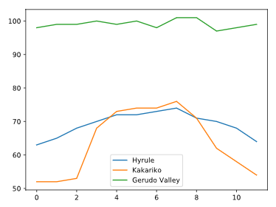
Line Graphs in Matplotlib: Legends Solution:
from matplotlib import pyplot as plt
months = range(12)
hyrule = [63, 65, 68, 70, 72, 72, 73, 74, 71, 70, 68, 64]
kakariko = [52, 52, 53, 68, 73, 74, 74, 76, 71, 62, 58, 54]
gerudo = [98, 99, 99, 100, 99, 100, 98, 101, 101, 97, 98, 99]
plt.plot(months, hyrule)
plt.plot(months, kakariko)
plt.plot(months, gerudo)
#create your legend here
legend_labels = ["Hyrule", "Kakariko", "Gerudo Valley"]
plt.legend(legend_labels, loc=8)
plt.show()

Slide 38
Line Graphs in Matplotlib: Modify Ticks
Why modify tick marks?
Because our plots can have multiple subplots, we have to specify which one we want to modify.
In order to do that, we call plt.subplot() as:
ax = plt.subplot(1, 1, 1)
ax is an axes object, and it lets us modify the axes belonging to a specific subplot.
Even if we only have one subplot, when we want to modify the ticks, we will need to start by calling either ax = plt.subplot(1, 1, 1) or ax = plt.subplot() in order to get our axes object.

Slide 39
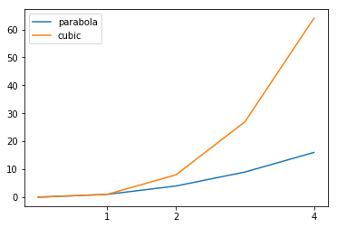
Line Graphs in Matplotlib
Suppose we wanted to set our x-ticks to be at 1, 2, and 4. We would use the following code:
ax = plt.subplot()
plt.plot([0, 1, 2, 3, 4], [0, 1, 4, 9, 16])
plt.plot([0, 1, 2, 3, 4], [0, 1, 8, 27, 64])
ax.set_xticks([1, 2, 4])
We can also modify the y-ticks by using ax.set_yticks().

Slide 40
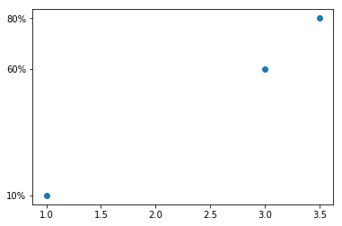
Line Graphs in Matplotlib
If we want special labels (such as strings), we can use the command ax.set_xticklabels() or ax.set_yticklabels().
For example, we might want to have a y-axis with ticks at 0.1, 0.6, and 0.8, but label them 10%, 60%, and 80%, respectively.
To do this, we use the following commands:
ax = plt.subplot()
plt.plot([1, 3, 3.5], [0.1, 0.6, 0.8], 'o')
ax.set_yticks([0.1, 0.6, 0.8])
ax.set_yticklabels(['10%', '60%', '80%'])

Slide 41
Lab Task 7:
Let’s imagine we are working for a company called Dinnersaur, that delivers dinners to people who don’t want to cook. Dinnersaur recently started a new service that is subscription-based, where users sign up for a whole year of meals, instead of buying meals on-demand.
We have plotted a line for you in the editor representing the proportion of users who have switched over to this new service since it was rolled out in January.
First, save the set of axes in a variable called ax. We will use ax to set the x- and y-ticks and labels to make this graph easier to read.
Using ax, set the x-ticks to be the months list.
Set the x-tick labels to be the month_names list.
Set the y-ticks to be [0.10, 0.25, 0.5, 0.75].
Label the y-ticks to be the percentages that correspond to the values [0.10, 0.25, 0.5, 0.75], instead of decimals.

Slide 42
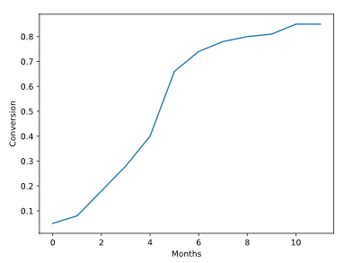
Lab Task 7:
from matplotlib import pyplot as plt
month_names = ["Jan", "Feb", "Mar", "Apr", "May", "Jun", "Jul", "Aug", "Sep","Oct", "Nov", "Dec"]
months = range(12)
conversion = [0.05, 0.08, 0.18, 0.28, 0.4, 0.66, 0.74, 0.78, 0.8, 0.81, 0.85, 0.85]
plt.xlabel("Months")
plt.ylabel("Conversion")
plt.plot(months, conversion)

Slide 43
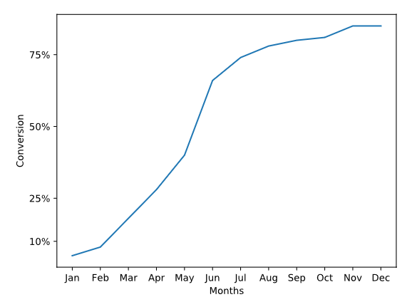
Solution
from matplotlib import pyplot as plt
month_names = ["Jan", "Feb", "Mar", "Apr", "May", "Jun", "Jul", "Aug", "Sep","Oct", "Nov", "Dec"]
months = range(12)
conversion = [0.05, 0.08, 0.18, 0.28, 0.4, 0.66, 0.74, 0.78, 0.8, 0.81, 0.85, 0.85]
plt.xlabel("Months")
plt.ylabel("Conversion")
plt.plot(months, conversion)
# Your work here
ax = plt.subplot()
ax.set_xticks(months)
ax.set_xticklabels(month_names)
ax.set_yticks([0.10, 0.25, 0.5, 0.75])
ax.set_yticklabels(["10%", "25%", "50%", "75%"])
plt.show()

Slide 44
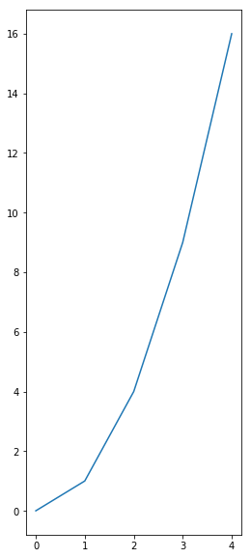
Line Graphs in Matplotlib: Figures
To create a figure with a width of 4 inches, and height of 10 inches, we would use:
plt.figure(figsize=(4, 10))
To save it, we can use the command plt.savefig() to save out to many different file formats, such as png, svg, or pdf.
After plotting, we can call plt.savefig('name_of_graph.png’)
# Figure 2
plt.figure(figsize=(4, 10))
plt.plot(x, parabola)
plt.savefig('tall_and_narrow.png')

Slide 45
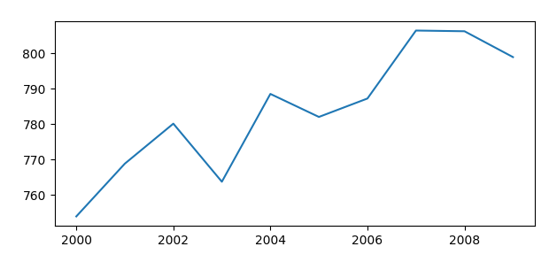
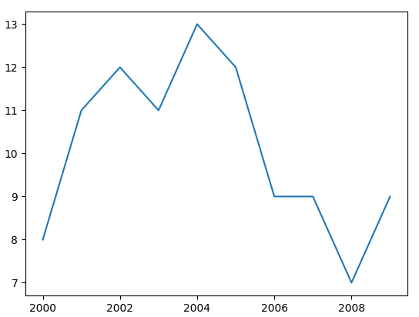
Line Graphs in Matplotlib: Figures
from matplotlib import pyplot as plt
word_length = [8, 11, 12, 11, 13, 12, 9, 9, 7, 9]
power_generated = [753.9, 768.8, 780.1, 763.7, 788.5, 782, 787.2, 806.4, 806.2, 798.9]
years = [2000, 2001, 2002, 2003, 2004, 2005, 2006, 2007, 2008, 2009]
plt.close('all')
plt.figure()
plt.plot(years, word_length)
plt.savefig('winning_word_lengths.png')
plt.figure(figsize=(7, 3))
plt.plot(years, power_generated)
plt.savefig('power_generated.png')

Slide 46
Final Exercise on Line Graphs in Matplotlib
Define three lists, x, y1, and y2 and fill them with integers. These numbers can be anything you want, but it would be neat to have them be actual metrics that you want to compare.
Plot y1 vs x and display the plot.
On the same graph, plot y2 vs x (after the line where you plot y1 vs x)
Make the y1 line a pink line and the y2 line a gray line. Give both lines round markers.
Give your graph a title of “Two Lines on One Graph”, and label the x-axis ”Amazing X-axis” and y-axis ”Incredible Y-axis”.
Give the graph a legend and put it in the lower right.

Slide 47
Solution:
from matplotlib import pyplot as plt
x = range(6)
y1 = [1, 2, 3, 4, 5, 6]
y2 = [-1, 1, 3, 4, 4, 4]
plt.plot(x, y1, marker='o', color='pink')
plt.plot(x, y2, marker='o', color='gray')
plt.title("Two Lines on One Graph")
plt.xlabel("Amazing X-axis")
plt.ylabel("Incredible Y-axis")
plt.legend(["Y1","Y2"], loc=4)
plt.show()

Slide 48
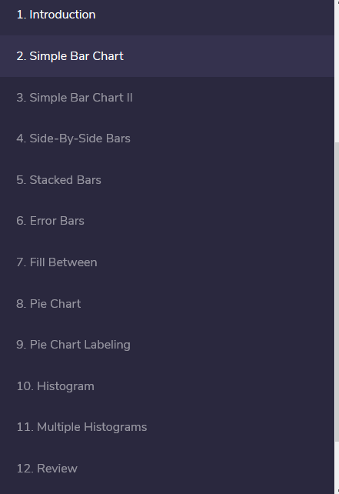

Slide 49
Simple Bar Chart
The plt.bar function allows you to create simple bar charts to compare multiple categories of data.
Some possible data that would be displayed with a bar chart:
x-axis — famous buildings, y-axis — heights
x-axis — different planets, y-axis — number of days in the year
x-axis — programming languages, y-axis — lines of code written by you
We call plt.bar with two arguments:
the x-values — a list of x-positions for each bar
the y-values — a list of heights for each bar
heights = [88, 225, 365, 687, 4333, 10756, 30687, 60190, 90553]
x_values = range(len(heights))

Slide 50
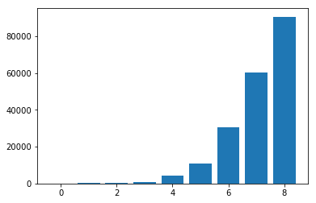
Simple Bar Chart
days_in_year = [88, 225, 365, 687, 4333, 10756, 30687, 60190, 90553]
plt.bar(range(len(days_in_year)), days_in_year)
plt.show()

Slide 51
Exercise 1
We are going to help the cafe MatplotSip analyze some of the sales data they have been collecting. In script.py, we have included a list of drink categories and a list of numbers representing the sales of each drink over the past month.
Use plt.bar to plot numbers of drinks sold on the y-axis. The x-values of the graph should just be the list [0, 1 ... , n-1], where n is the number of categories (drinks) we are plotting. So at x=0, we’ll have the number of cappuccinos sold.
Show the plot and examine it. At this point, we can’t tell which bar corresponds to which drink, so this chart is not very helpful. We’ll fix this in the next section.
from matplotlib import pyplot as plt
drinks = ["cappuccino", "latte", "chai", "americano", "mocha", "espresso"]
sales = [91, 76, 56, 66, 52, 27]

Slide 52
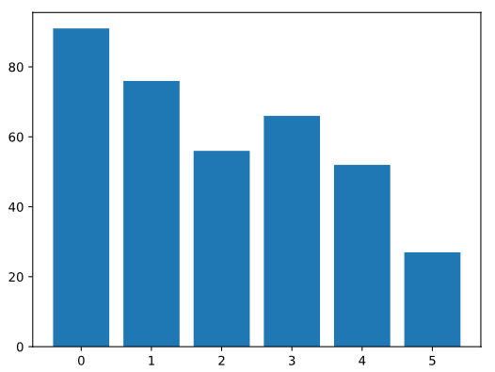
Solution:
from matplotlib import pyplot as plt
drinks = ["cappuccino", "latte", "chai", "americano", "mocha", "espresso"]
sales = [91, 76, 56, 66, 52, 27]
plt.bar(range(len(sales)), sales)
plt.show()

Slide 53
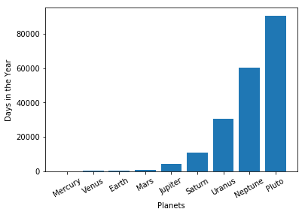
Simple Bar Chart II
In the drinks chart from the last exercise, we could see that sales were different for different drink items, but this wasn’t very helpful to us, since we didn’t know which bar corresponded to which drink.
To customize the tick marks on the x-axis:
(a) Create an axes object
ax = plt.subplot()
(b) Set the x-tick positions using a list of numbers
ax.set_xticks([0, 1, 2, 3, 4, 5, 6, 7, 8])
(c) Set the x-tick labels using a list of strings
ax.set_xticklabels(['Mercury', 'Venus', 'Earth', 'Mars', 'Jupiter', 'Saturn', 'Uranus', 'Neptune', 'Pluto’])
(d) If your labels are particularly long, you can use the rotation keyword to rotate your labels by a specified number of degrees:
ax.set_xticklabels(['Mercury', 'Venus', 'Earth', 'Mars', 'Jupiter', 'Saturn', 'Uranus', 'Neptune', 'Pluto’], rotation=30)

Slide 54
Exercise:
The list drinks represents the drinks sold at MatplotSip. We are going to set x-tick labels on the chart you made with plt.bar in the last exercise.
First, create the axes object for the plot and store it in a variable called ax.
Set the x-axis ticks to be the numbers from 0 to the length of drinks.
Use the strings in the drinks list for the x-axis ticks of the plot you made with plt.bar.
from matplotlib import pyplot as plt
drinks = ["cappuccino", "latte", "chai", "americano", "mocha", "espresso"]
sales = [91, 76, 56, 66, 52, 27]
plt.bar(range(len(drinks)), sales)
#create your ax object here
plt.show()

Slide 55
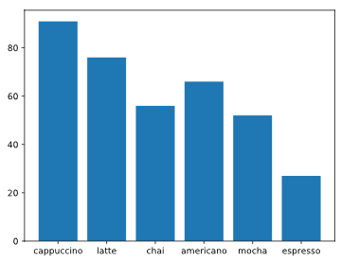
Solution:
from matplotlib import pyplot as plt
drinks = ["cappuccino", "latte", "chai", "americano", "mocha", "espresso"]
sales = [91, 76, 56, 66, 52, 27]
plt.bar(range(len(drinks)), sales)
ax = plt.subplot()
ax.set_xticks(range(6))
ax.set_xticklabels(drinks)
plt.show()

Slide 56
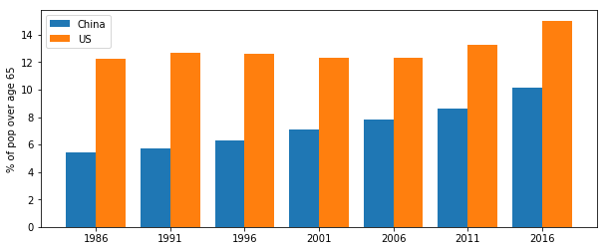
Side-By-Side Bars
We can use a bar chart to compare two sets of data with the same types of axis values.
To do this, we plot two sets of bars next to each other, so that the values of each category can be compared.
For example, here is a chart with side-by-side bars for the populations of the United States and China over the age of 65 (in percentages):

Slide 57
# China Data (blue bars)
n = 1 # This is our first dataset (out of 2)
t = 2 # Number of datasets
d = 7 # Number of sets of bars
w = 0.8 # Width of each bar
x_values1 = [t*element + w*n for element in range(d)]
# US Data (orange bars)
n = 2 # This is our second dataset (out of 2)
t = 2 # Number of datasets
d = 7 # Number of sets of bars
w = 0.8 # Width of each bar
x_values2 = [t*element + w*n for element in range(d)]

Slide 58
Exercise
The second location of MatplotSip recently opened up, and the owners want to compare the drink choices of the clientele at the two different locations.
To do this, it will be helpful to have the sales of each drink plotted on the same axes. We have provided sales2, a list of values representing the sales of the same drinks at the second MatplotSip location.
Use the plt.bar to position the bars corresponding to sales1 on the plot. The x-values for plt.bar should be the store1_x list that you just created.
from matplotlib import pyplot as plt
drinks = ["cappuccino", "latte", "chai", "americano", "mocha", "espresso"]
sales1 = [91, 76, 56, 66, 52, 27]
sales2 = [65, 82, 36, 68, 38, 40]

Slide 59
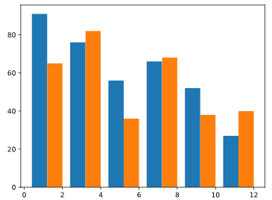
Solution
from matplotlib import pyplot as plt
drinks = ["cappuccino", "latte", "chai", "americano", "mocha", "espresso"]
sales1 = [91, 76, 56, 66, 52, 27]
sales2 = [65, 82, 36, 68, 38, 40]
#Paste the x_values code here
n = 1 # This is our first dataset (out of 2)
t = 2 # Number of dataset
d = 6 # Number of sets of bars
w = 0.8 # Width of each bar
store1_x = [t*element + w*n for element in range(d)]
plt.bar(store1_x, sales1)
#Paste the x_values code here
n = 2 # This is our second dataset (out of 2)
t = 2 # Number of dataset
d = 6 # Number of sets of bars
w = 0.8 # Width of each bar
store2_x = [t*element + w*n for element in range(d)]
plt.bar(store2_x, sales2)
plt.show()

Slide 60
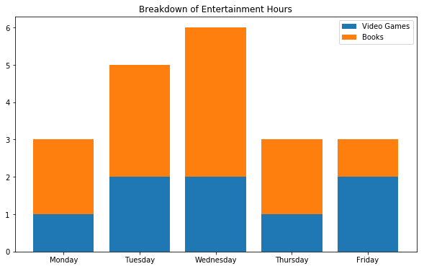
Stacked Bars
If we want to compare two sets of data while preserving knowledge of the total between them, we can also stack the bars instead of putting them side by side.
For instance, if someone was plotting the hours they’ve spent on entertaining themselves with video games and books in the past week and the second set of bars has bottom specified:
video_game_hours = [1, 2, 2, 1, 2]
plt.bar(range(len(video_game_hours)), video_game_hours)
book_hours = [2, 3, 4, 2, 1]
plt.bar(range(len(book_hours)), book_hours, bottom=video_game_hours)

Slide 61
Exercise
You just made a chart with two sets of sales data plotted side by side. Let’s instead make a stacked bar chart by using the keyword bottom.
Put the sales1 bars on the bottom and set the sales2 bars to start where the sales1 bars end.
We should add a legend to make sure we know which set of bars corresponds to which location.
Label the bottom set of bars as “Location 1” and the top set of bars as “Location 2” and add a legend to the chart.
from matplotlib import pyplot as plt
drinks = ["cappuccino", "latte", "chai", "americano", "mocha", "espresso"]
sales1 = [91, 76, 56, 66, 52, 27]
sales2 = [65, 82, 36, 68, 38, 40]
plt.show()

Slide 62
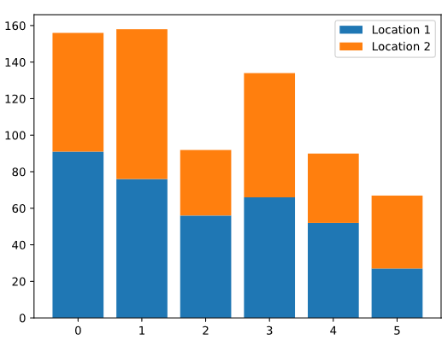
Solution:
from matplotlib import pyplot as plt
drinks = ["cappuccino", "latte", "chai", "americano", "mocha", "espresso"]
sales1 = [91, 76, 56, 66, 52, 27]
sales2 = [65, 82, 36, 68, 38, 40]
plt.bar(range(len(drinks)), sales1)
plt.bar(range(len(drinks)), sales2, bottom=sales1)
plt.legend(["Location 1", "Location 2"])
plt.show()

Slide 63
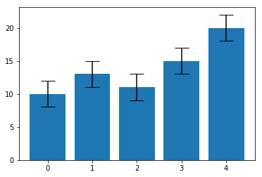
Error Bars
Sometimes, we need to visually communicate some sort of uncertainty in the heights of those bars. Here are some examples:
The average number of students in a 3rd grade classroom is 30, but some classes have as few as 18 and others have as many as 35 students.
We measured that the weight of a certain fruit was 35g, but we know that our scale isn’t very precise, so the true weight of the fruit might be as much as 40g or as little as 30g.
The average price of a soda is $1.00, but we also want to communicate that the standard deviation is $0.20.
To display error visually in a bar chart, we often use error bars to show where each bar could be, taking errors into account.

Slide 64
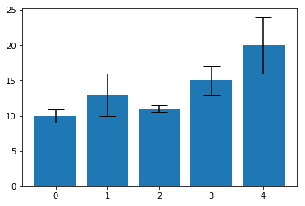
Each of the black lines is called an error bar.
The taller the bar is, the more uncertain we are about the height of the blue bar.
If we wanted to show an error of +/- 2, we would add the keyword yerr=2 to our plt.bar command.
The horizontal lines at the top and bottom are called caps. They make it easier to read the error bars.
To make the caps wide and easy to read, we would add the keyword capsize=10
values = [10, 13, 11, 15, 20]
yerr = 2
plt.bar(range(len(values)), values, yerr=yerr, capsize=10)
plt.show()
If we want a different amount of error for each bar, we can make yerr equal to a list rather than a single number:
values = [10, 13, 11, 15, 20]
yerr = [1, 3, 0.5, 2, 4]
plt.bar(range(len(values)), values, yerr=yerr, capsize=10)
plt.show()

Slide 65
Exercise
For someone who is learning about the different drink types at MatplotSip, a bar chart of milk amounts in each drink may be useful. We have provided the ounces_of_milk list, which contains the amount of milk in each 12oz drink in the drinks list. Plot this information as a bar chart.
According to different barista styles and measurement errors, there might be variation on how much milk actually goes into each drink. We’ve included a list error, with an error of 10% on each amount of milk. Display this error as error bars on the bar graph.
Add caps of size 5 to your error bars.
from matplotlib import pyplot as plt
drinks = ["cappuccino", "latte", "chai", "americano", "mocha", "espresso"]
ounces_of_milk = [6, 9, 4, 0, 9, 0]
error = [0.6, 0.9, 0.4, 0, 0.9, 0]
# Plot the bar graph here
plt.show()

Slide 66
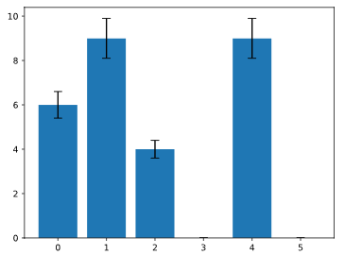
Solution:
from matplotlib import pyplot as plt
drinks = ["cappuccino", "latte", "chai", "americano", "mocha", "espresso"]
ounces_of_milk = [6, 9, 4, 0, 9, 0]
error = [0.6, 0.9, 0.4, 0, 0.9, 0]
# Plot the bar graph here
plt.bar(range(len(drinks)), ounces_of_milk, yerr=error, capsize=5)
ax.set_xticklabels(drinks)
plt.show()

Slide 67
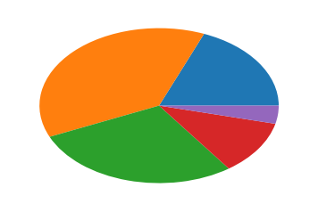
Pie Chart
If we want to display elements of a data set as proportions of a whole, we can use a pie chart.
Pie charts are helpful for displaying data like:
Different ethnicities that make up a school district
Different macronutrients (carbohydrates, fat, protein) that make up a meal
Different responses to an online poll
We can make a pie chart with the command plt.pie, passing in the values you want to chart:
budget_data = [500, 1000, 750, 300, 100]
plt.pie(budget_data)
plt.show()

Slide 68
Exercise:
MatplotSip keeps track of how many people pay by credit card, cash, Apple pay, or other methods. This is given to you in the payment_method_names and payment_method_freqs lists.
Display the payment_method_freqs list as a pie chart.
Now, set the axes to be equal.
from matplotlib import pyplot as plt
import numpy as np
payment_method_names = ["Card Swipe", "Cash", "Apple Pay", "Other"]
payment_method_freqs = [270, 77, 32, 11]
#make your pie chart here
plt.show()

Slide 69
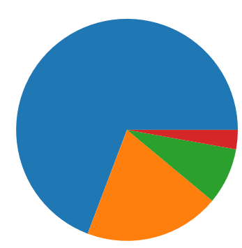
Solution:
from matplotlib import pyplot as plt
import numpy as np
payment_method_names = ["Card Swipe", "Cash", "Apple Pay", "Other"]
payment_method_freqs = [270, 77, 32, 11]
#make your pie chart here
plt.pie(payment_method_freqs)
plt.axis('equal')
plt.show()

Slide 70
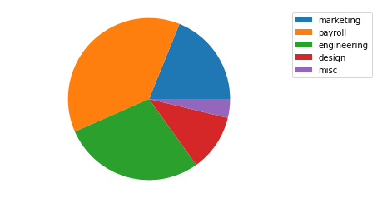
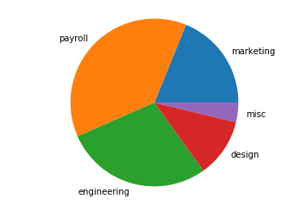
Pie Chart Labeling
We also want to be able to understand what each slice of the pie represents. To do this, we can either:
use a legend to label each color, or
put labels on the chart itself.
budget_data = [500, 1000, 750, 300, 100]
budget_categories = ['marketing', 'payroll', 'engineering', 'design', 'misc']
plt.pie(budget_data)
plt.legend(budget_categories)
#option 2
plt.pie(budget_data, labels=budget_categories)

Slide 71
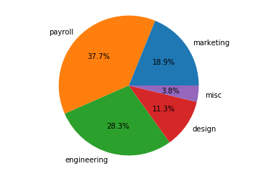
Pie Chart Labeling
Pie charts is added with the percentage of the total that each slice occupies.
Matplotlib can add this automatically with the keyword autopct.
Some common formats are:
'%0.2f' — 2 decimal places, like 4.08
'%0.2f%%' — 2 decimal places, but with a percent sign at the end, like 4.08%.
'%d%%' — rounded to the nearest int and with a percent sign at the end, like 4%.
plt.pie(budget_data, labels=budget_categories, autopct='%0.1f%%')

Slide 72

Excercise
Add a legend to the chart you made in the previous exercise by passing in a list of labels to plt.legend. For the labels, use the list payment_method_names.
Add a percentage to each slice using Matplotlib’s autopct parameter. Go to one decimal point of precision.
import codecademylib
from matplotlib import pyplot as plt
payment_method_names = ["Card Swipe", "Cash", "Apple Pay", "Other"]
payment_method_freqs = [270, 77, 32, 11]
plt.pie(payment_method_freqs)
plt.axis('equal')
plt.show()

Slide 73

Solution
from matplotlib import pyplot as plt
payment_method_names = ["Card Swipe", "Cash", "Apple Pay", "Other"]
payment_method_freqs = [270, 77, 32, 11]
plt.pie(payment_method_freqs, autopct="%0.1f%%")
plt.axis('equal')
plt.legend(payment_method_names)
plt.show()

Slide 74

Histogram
A histogram tells us how many values in a dataset fall between different sets of numbers (i.e., how many numbers fall between 0 and 10? Between 10 and 20? Between 20 and 30?).
Each of these questions represents a bin, for instance, our first bin might be between 0 and 10.
All bins in a histogram are always the same size.
The width of each bin is the distance between the minimum and maximum values of each bin.
In our example, the width of each bin would be 12.
To make a histogram in Matplotlib, we use the command plt.hist
plt.hist(dataset)
plt.show()
plt.hist finds the minimum and the maximum values in your dataset and creates 10 equally-spaced bins between those values.

Slide 75

If we want more than 10 bins, we can use the keyword bins to set how many bins we want to divide the data into.
The keyword range selects the minimum and maximum values to plot.
plt.hist(dataset, range=(66,69), bins=40)

Slide 76

from matplotlib import pyplot as plt
def convert_time_to_num(time):
mins = int(time[-2:])
frac_of_hour = mins/60.0
hour = int(time[:-3])
time = hour + frac_of_hour
return time
sales_times_raw = []
with open('sales_times.csv') as csvDataFile:
csvReader = csv.reader(csvDataFile)
for row in csvReader:
sales_times_raw.append(row[2])
sales_times_raw = sales_times_raw[1:]
sales_times = []
for time in sales_times_raw:
sales_times.append(convert_time_to_num(time))
#create the histogram here
plt.hist(sales_times, bins=20)
plt.show()
Sample Data of the Dataset
id,card_no,time
1,3531391693620796,19:21

Slide 77


Multiple Histograms
plt.hist(a, range=(55, 75), bins=20, alpha=0.5)
plt.hist(b, range=(55, 75), bins=20, alpha=0.5)
If we want to compare two different distributions, we can put multiple histograms on the same plot.
This could be useful, for example, in comparing the heights of a bunch of men and the heights of a bunch of women.
However, it can be hard to read two histograms on top of each other.
For example, in this histogram, we can’t see all of the blue plot, because it’s covered by the orange one:
Use the keyword alpha, which can be a value between 0 and 1. This sets the transparency of the histogram.
A value of 0 would make the bars entirely transparent.
A value of 1 would make the bars completely opaque.

Slide 78

use the keyword histtype with the argument 'step' to draw just the outline of a histogram:
plt.hist(a, range=(55, 75), bins=20, histtype='step')
plt.hist(b, range=(55, 75), bins=20, histtype='step')

Slide 79
Seaborn
“If Matplotlib “tries to make easy things easy and hard things possible”, seaborn tries to make a well-defined set of hard things easy too” – Michael Waskom (Creator of Seaborn).
When working with Pandas, Matplotlib doesn’t serve well with DataFrames, while Seaborn functions actually work on DataFrames.
Python Seaborn library is used to ease the challenging task of data visualization
It is based on Matplotlib.

Slide 80
Seaborn
Seaborn allows the creation of statistical graphics through the following functionalities:
Allow comparison between multiple variables of multiple datasets
Supports multi-plot grids that in turn ease building complex visualizations
Univariate and bivariate visualizations available to compare between subsets of data
Availability of different color palettes to reveal various kinds of patterns
Estimates and plots linear regression automatically

Slide 81
Seaborn to visualize a Pandas DataFrame
DataFrames contain data structured into rows and columns.
You can create a DataFrame from a local CSV file (CSV files store data in a tabular format).
To create a DataFrame from a local CSV file you would use the syntax:
df = pd.read_csv('file_name.csv')
The code creates a DataFrame saved to a variable named df.
The data inside of the df DataFrame comes from the data in the local CSV file named file_name.csv.

Slide 82

Seaborn to visualize a Pandas DataFrame
import warnings
warnings.filterwarnings('ignore')
import pandas as pd
from matplotlib import pyplot as plt
import seaborn as sns
df = pd.read_csv('survey.csv')
print(df.head())

Slide 83

Plotting Bars with Matplotlab vs Seaborn
Problem: Suppose we are analyzing data from a survey: we asked 1,000 patients at a hospital how satisfied they were with their experience. Their response was measured on a scale of 1 - 10, with 1 being extremely unsatisfied, and 10 being extremely satisfied. We have summarized that data in a CSV file called results.csv.
df = pd.read_csv("results.csv")
ax = plt.subplot()
plt.bar(range(len(df)), df["Mean Satisfaction"])
ax.set_xticks(range(len(df)))
ax.set_xticklabels(df.Gender)
plt.xlabel("Gender")
plt.ylabel("Mean Satisfaction")

Slide 84
Plotting Bars with Matplotlab vs Seaborn
The Seaborn function sns.barplot(), takes at least three keyword arguments:
data: a Pandas DataFrame that contains the data (in this example, data=df)
x: a string that tells Seaborn which column in the DataFrame contains other x-labels (in this case, x="Gender")
y: a string that tells Seaborn which column in the DataFrame contains the heights we want to plot for each bar (in this case y="Mean Satisfaction")
By default, Seaborn will aggregate and plot the mean of each category.

Slide 85
Task 1:
1. Use Pandas to load in the data from results.csv and save it to the variable df.
2. Display df using print
3. Remove all of the # characters from in front of the sns.barplot command and fill in the missing values.
4. Type plt.show() to display the completed bar plot.
import warnings
warnings.filterwarnings('ignore')
import pandas as pd
from matplotlib import pyplot as plt
import seaborn as sns
# Load results.csv here:
# sns.barplot(
# data= ,
# x= ,
# y=
# )

Slide 86

Task 1 Solution:
import warnings
warnings.filterwarnings('ignore')
import pandas as pd
from matplotlib import pyplot as plt
import seaborn as sns
# Load results.csv here:
df = pd.read_csv('results.csv')
print(df)
sns.barplot(
data=df,
x='Gender',
y='Mean Satisfaction'
)
plt.show()

Slide 87
Understanding Aggregates
Seaborn can also calculate aggregate statistics for large datasets.
An aggregate statistic, or aggregate, is a single number used to describe a set of data. One example of an aggregate is the average, or mean of a data set.
Suppose we have a grade book with columns student, assignment_name, and grade, as shown below.
To calculate a student’s current grade in the class, we need to aggregate the grade data by student.
student | assignment_name | grade
Amy | Assignment 1 | 75
Amy | Assignment 2 | 82
Bob | Assignment 1 | 99
Bob | Assignment 2 | 90
Chris | Assignment 1 | 72
Chris | Assignment 2 | 66
… | … | …
student | grade
Amy | 78.5
Bob | 94.5
Chris | 69
… | …
assignment_name | grade
Assignment 1 | 82
Assignment 2 | 79.3
… | …

Slide 88
Task 2:
import codecademylib3_seaborn
import pandas as pd
from matplotlib import pyplot as plt
gradebook = pd.read_csv("gradebook.csv")
In Python, you can compute aggregates fairly quickly and easily using Numpy.
To calculate aggregates using Numpy, you’ll first need to import the Numpy library
import numpy as np
The DataFrame gradebook contains the complete gradebook for a hypothetical classroom. Use print to examine gradebook.
Select all rows from the gradebook DataFrame where assignment_name is equal to Assignment 1. Save the result to the variable assignment1. Print assignment1.
Now use Numpy to calculate the median grade in assignment1. Use np.median() to calculate the median of the column grade from assignment1 and save it to asn1_median.
Display asn1_median using print. What is the median grade on Assignment 1?

Slide 89

Task 2 Solution:
import codecademylib3_seaborn
import pandas as pd
from matplotlib import pyplot as plt
import numpy as np
gradebook = pd.read_csv('gradebook.csv')
print(gradebook)
assignment1 = gradebook[gradebook.assignment_name == 'Assignment 1']
print(assignment1)
asn1_median = np.median(assignment1.grade)
print(asn1_median)

Slide 90
Plotting Aggregates using Seaborn
student | assignment_name | grade
Amy | Assignment 1 | 75
Amy | Assignment 2 | 82
Bob | Assignment 1 | 99
Bob | Assignment 2 | 90
Chris | Assignment 1 | 72
Chris | Assignment 2 | 66
… | … | …
Suppose this data is stored in a Pandas DataFrame called df.
The Seaborn command (sns.barplot()) will plot this data in a bar plot and automatically aggregate the data:
sns.barplot(data=df, x="student", y="grade")
In the example above, Seaborn will aggregate grades by student, and plot the average grade for each student.
Task 3:
1. Use Seaborn to plot the average grade for each assignment. Take a look at gradebook.csv for the column names.
2. Use plt.show() to display the graph.

Slide 91

Task 3 Solution:
import warnings
warnings.filterwarnings('ignore')
import pandas as pd
from matplotlib import pyplot as plt
import seaborn as sns
gradebook = pd.read_csv("gradebook.csv")
sns.barplot(data=gradebook, x="assignment_name", y="grade")
plt.show()

Slide 92

Modifying Error Bars
By default, Seaborn will place error bars on each bar when you use the barplot() function.
For example, in our assignment average example, an error bar might indicate what grade we expect an average student to receive on this assignment.
By default, Seaborn uses a bootstrapped confidence interval.
This interval means that “based on this data, 95% of similar situations would have an outcome within this range”.
In our gradebook example, the confidence interval for the assignments means “if we gave this assignment to many, many students, we’re confident that the mean score on the assignment would be within the range represented by the error bar”.

Slide 93

Modifying Error Bars
If you’re calculating a mean and would prefer to use standard deviation for your error bars, you can pass in the keyword argument ci="sd" to sns.barplot() which will represent one standard deviation.
sns.barplot(data=gradebook, x="name", y="grade", ci="sd")
Task 4:
Modify the bar plot so that the error bars represent one standard deviation, rather than 95% confidence intervals.
gradebook = pd.read_csv("gradebook.csv")
sns.barplot(data=gradebook, x="name", y="grade", ci="sd")
plt.show()

Slide 94
Calculating Different Aggregates
In most cases, we’ll want to plot the mean of our data, but sometimes, we’ll want something different:
If our data has many outliers, we may want to plot the median.
If our data is categorical, we might want to count how many times each category appears (such as in the case of survey responses).
To do so, you’ll need to use the keyword argument estimator, which accepts any function that works on a list.
For example, to calculate the median, you can pass in np.median to the estimator keyword:
Consider the data in results.csv. To calculate the number of times a particular value appears in the Response column , we pass in len:
sns.barplot(data=df,
x="x-values",
y="y-values",
estimator=np.median)
sns.barplot(data=df,
x="Patient ID",
y="Response",
estimator=len)

Slide 95
Task 5:
1. Consider our hospital satisfaction survey data, which is loaded into the Pandas DataFrame df. Use print to examine the data.
2. We’d like to know how many men and women answered the survey. Use sns.barplot() with:
data equal to df
x equal to Gender
y equal to Response
estimator equal to len
3. Change sns.barplot() to graph the median Response aggregated by Gender using estimator=np.median.
import warnings
warnings.filterwarnings('ignore')
import numpy as np
import pandas as pd
from matplotlib import pyplot as plt
import seaborn as sns
df = pd.read_csv("survey.csv")

Slide 96




Task 4 Solution:
import warnings
warnings.filterwarnings('ignore')
import numpy as np
import pandas as pd
from matplotlib import pyplot as plt
import seaborn as sns
df = pd.read_csv("survey.csv")
print(df)
#sns.barplot(data=df,
# x='Gender',
# y='Response',
# estimator=len)
sns.barplot(data=df,
x='Gender',
y='Response',
estimator=np.median)
plt.show()

Slide 97

Aggregating by Multiple Columns
For example, consider our hospital survey data. The mean satisfaction (Response here) seems to depend on Gender, but it might also depend on another column: Age Range.
We can compare both the Gender and Age Range factors at once by using the keyword hue.
sns.barplot(data=df,
x="Gender",
y="Response",
hue="Age Range")
The hue parameter adds a nested categorical variable to the plot.
Visualizing survey results by gender with age range nested

Slide 98


Visualizing survey results by gender with age range nested
import pandas as pd
from matplotlib import pyplot as plt
import seaborn as sns
df = pd.read_csv("survey.csv")
sns.barplot(data=df,
x="Age Range",
y="Response",
hue="Gender")
plt.show()

Slide 99
Load_dataset with Seaborn
Import the required libraries as follows:
import numpy as np
import pandas as pd
import matplotlib.pyplot as plt
import seaborn as sns
sns.set(style="darkgrid")
Seaborn allows you to load any dataset from GIT using the load_dataset() function.
f = sns.load_dataset("flights")
You can also view all the available datasets using get_dataset_names() function as follows:
sns.get_dataset_names()

Slide 100
Built-in Themes
Seaborn has five built-in themes to style its plots: darkgrid, whitegrid, dark, white, and ticks. Seaborn defaults to using the darkgrid theme for its plots, but you can change this styling
To use any of the preset themes pass the name of it to sns.set_style().
Style attribute can take any value such as darkgrid, ticks, etc.
sns.set_style("darkgrid")
sns.stripplot(x="day", y="total_bill", data=a)

Slide 101


Scaling Figure Styles for Different Mediums
Styling plots for different presentation purposes is difficult in Matplotlib.
Seaborn makes it easy to produce the same plots in a variety of different visual formats so you can customize the presentation of your data for the appropriate context.
Seaborn has four presets (paper, notebook, talk, and poster ) which set the size of the plot and allow you to customize your figure depending on how it will be presented.
The notebook style is the default.
sns.set_style("ticks")
# Smallest context:
sns.set_context("paper")
sns.stripplot(x="day", y="total_bill", data=tips)

Slide 102
relplot():
This is a figure-level-function that makes use of two other axes functions for Visualizing Statistical Relationships using two common approaches: scatter plots and line plots:
scatterplot()
lineplot()
These functions can be specified using the ‘kind’ parameter of relplot().
It takes the default one which is scatterplot().

Slide 103


relplot():
f = sns.load_dataset("flights")
sns.relplot(x="passengers", y="month", data=f);
f = sns.load_dataset("flights")
sns.relplot(x="passengers", y="month", hue="year", data=f);
We can add another dimension using the ‘hue’.

Slide 104

More customizations
sns.set(style="darkgrid")
f = sns.load_dataset("flights")
sns.relplot(x="passengers", y="month", hue="year", palette="ch:r=-.5,l=.75", data=f);

Slide 105
Plotting Distributions with Seaborn
Seaborn is optimized to work with large datasets — from its ability to natively interact with Pandas DataFrames, to automatically calculating and plotting aggregates.
One of the most powerful aspects of Seaborn is its ability to visualize and compare distributions.
Distributions provide us with more information about our data — how spread out it is, its range, etc.
Seaborn includes several plots that allow you to graph univariate distribution, including KDE plots, box plots, and violin plots.

Slide 106

Plotting Distributions with Seaborn
import numpy as np
import pandas as pd
import matplotlib.pyplot as plt
import seaborn as sns
n = 500
#Load data from a text file
dataset1 = np.genfromtxt("dataset1.csv", delimiter=",")
dataset2 = np.genfromtxt("dataset2.csv", delimiter=",")
dataset3 = np.genfromtxt("dataset3.csv", delimiter=",")
df = pd.DataFrame({
"label": ["set_one"] * n + ["set_two"] * n + ["set_three"] * n,
"value": np.concatenate([dataset1, dataset2, dataset3])
})
sns.set()
sns.barplot(data=df, x='label', y='value')
plt.show()

Slide 107

KDE Plots
KDE stands for Kernel Density Estimator. A KDE plot gives us the sense of a univariate as a curve.
A univariate dataset only has one variable
KDE plots are preferable to histograms because depending on how you group the data into bins and the width of the bins, you can draw wildly different conclusions about the shape of the data.
Using a KDE plot can mitigate these issues, because they smooth the datasets, allow us to generalize over the shape of our data

Slide 108

KDE Plots
To plot a KDE in Seaborn, we use the method sns.kdeplot().
A KDE plot takes the following arguments:
data - the univariate dataset being visualized, like a Pandas DataFrame, Python list, or NumPy array
shade - a boolean that determines whether or not the space underneath the curve is shaded
Let’s examine the KDE plots of our three datasets:
sns.kdeplot(dataset1, shade=True)
sns.kdeplot(dataset2, shade=True)
sns.kdeplot(dataset3, shade=True)
plt.legend()
plt.show()
Dataset 1 is skewed left
Dataset 2 is normally distributed
Dataset 3 is bimodal (it has two peaks)

Slide 109

KDE Plots
We can use barplots to find out information about the mean - but it doesn't give us a sense of how spread out the data is in each set.
To find out more about the distribution, we can use a KDE plot.
sns.kdeplot(dataset1, shade=True, label="dataset1")
sns.kdeplot(dataset2, shade=True, label="dataset2")
sns.kdeplot(dataset3, shade=True, label="dataset3")
plt.legend()
plt.show()

Slide 110

Box Plots
The box plot (also known as a box-and-whisker plot) can tell us about how our dataset is distributed.
It gives us an idea about where a significant portion of our data lies, and whether or not any outliers are present.
The box represents the interquartile range
The line in the middle of the box is the median
The end lines are the first and third quartiles
The diamonds show outliers
However, we lose the ability to determine
the shape of the data

Slide 111

Box Plots
A box plot takes the following arguments:
data - the dataset we’re plotting, like a DataFrame, list, or an array
x - a one-dimensional set of values, like a Series, list, or array
y - a second set of one-dimensional data
sns.boxplot(data=df, x='label', y='value')
plt.show()
if you use the value Series as your y value data, Seaborn will automatically apply that name as the y-axis label.

Slide 112

Violin plots
Violin plots provide more information than box plots because instead of mapping each individual data point, we get an estimation of the dataset using the KDE.
There are two KDE plots that are symmetrical along the center line.
A white dot represents the median.
The thick black line in the center of each violin represents the interquartile range.
The lines that extend from the center are the confidence intervals - just as we saw on the bar plots, a violin plot also displays the 95% confidence interval.

Slide 113

Violin plots
A violin plot brings together shape of the KDE plot with additional information that a box plot provides.
sns.violinplot(data=df, x="label", y="value")
plt.show()

Slide 114
Seaborn Styling, Part 1: Figure Style and Scale
Styling is the process of customizing the overall look of your visualization, or figure.
Making intentional decisions about the details of the visualization will increase their impact
Seaborn enables you to change the presentation of your figures by changing the style of elements like the background color, grids, and spines.
1. Built-in Themes:
Seaborn has five built-in themes to style its plots: darkgrid, whitegrid, dark, white, and ticks.
Seaborn defaults to using the darkgrid theme for its plots

Slide 115


Seaborn Styling, Part 1: Figure Style and Scale
To use any of the preset themes pass the name of it to sns.set_style().
sns.set_style("darkgrid")
sns.stripplot(x="day", y="total_bill", data=tips)
The white and tick themes will allow the colors of your dataset to show more visibly and provides higher contrast so your plots are more legible:
sns.set_style("ticks")
sns.stripplot(x="day", y="total_bill", data=tips)

Slide 116

Styling:
import seaborn as sns
import matplotlib.pyplot as plt
sns.set(style="white", color_codes=True)
a = sns.load_dataset("tips")
sns.boxplot(x="day", y="total_bill", data=a)
Theme is changed to white

Slide 117


Seaborn Styling, Part 1: Figure Style and Scale 2. Grids:
To define the background color of your figure, you can also choose whether or not to include a grid.
A grid allows the audience to read your chart and get specific information about certain values. Research papers and reports are a good example of when you would want to include a grid.
sns.set_style("whitegrid")
sns.stripplot(x="day", y="total_bill", data=a)
There are also instances where it would make more sense to not use a grid.
sns.set_style("white")
sns.stripplot(x="day", y="total_bill", data=a)

Slide 118


Seaborn Styling, Part 1: Figure Style and Scale 3. Despine
Spines are the borders of the figure that contain the visualization.
By default, an image has four spines.
You can automatically take away the top and right spines using the sns.despine()function.
sns.set_style("white")
sns.stripplot(x="day", y="total_bill", data=a)
sns.despine()
You can also specify how many spines you want to include by calling despine() and passing in the spines you want to get rid of, such as: left, bottom, top, right.
sns.set_style("whitegrid")
sns.stripplot(x="day", y="total_bill", data=a)
sns.despine(left=True, bottom=True)

Slide 119


4. Working with Palettes
Seaborn Styling, Part 1: Figure Style and Scale
You can build color palettes using the function sns.color_palette().
This function can take any of the Seaborn built-in palettes (see below). You can also build your own palettes
use the function sns.palplot() to plot a palette as an array of colors
# Save a palette to a variable:
palette = sns.color_palette("bright")
# Use palplot and pass in the variable:
sns.palplot(palette)

Slide 120

import seaborn as sns
import matplotlib.pyplot as plt
sns.set(style="white", color_codes=True)
a = sns.load_dataset("tips")
sns.boxplot(x="day", y="total_bill", data=a);
sns.despine(offset=10, trim=True);

Slide 121

4. Working with Palettes
To select and set a palette in Seaborn, use the command sns.set_palette() and pass in the name of the palette that you would like to use:
# Set the palette using the name of a palette:
sns.set_palette("Paired")
# Plot a chart:
sns.stripplot(x="day", y="total_bill", data=tips)

Slide 122

4. Working with Palettes
To use one of these palettes, pass the name into sns.set_palette():
# Set the palette to the "pastel" default palette:
sns.set_palette("pastel")
# plot using the "pastel" palette
sns.stripplot(x="day", y="total_bill", data=tips)

Slide 123

lineplot():
This function will allow you to draw a continuous line for your data. You can use this function by changing the ‘kind’ parameter as follows:
a=pd.DataFrame({'Day':[1,2,3,4,5,6,7],'Grocery':[30,80,45,23,51,46,76],'Clothes':[13,40,34,23,54,67,98],'Utensils':[12,32,27,56,87,54,34]},index=[1,2,3,4,5,6,7])
sns.relplot(x="Day", y="Clothes", kind="line", data=a)

Slide 124
Plotting with Categorical Data:
This approach is used when our main variable is further divided into discrete groups (categorical).
This can be achieved using the catplot() function.
catplot():
It can be characterized by three families of axes level functions namely:
Scatterplots – These include stripplot(), swarmplot()
Distribution Plots – which are boxplot(), violinplot(), boxenplot()
Estimateplots – namely pointplot(), barplot(), countplot()

Slide 125


Plotting with Categorical Data:
import seaborn as sns
import matplotlib.pyplot as plt
sns.set(style="ticks", color_codes=True)
a = sns.load_dataset("tips")
sns.catplot(x="day", y="total_bill", data=a);
_____________________________________________________
import seaborn as sns
import matplotlib.pyplot as plt
sns.set(style="ticks", color_codes=True)
a = sns.load_dataset("tips")
sns.catplot(x="day", y="total_bill", kind="violin", data=a);

Slide 126

Visualizing the distribution of a dataset:
Plotting Univariate distributions: To plot them, you can make use of distplot() function as follows:
import numpy as np
import pandas as pd
import seaborn as sns
import matplotlib.pyplot as plt
from scipy import stats
sns.set(color_codes=True)
a = np.random.normal(loc=5,size=100,scale=2)
sns.distplot(a);
We have plotted a graph for the variable a whose values are generated by the normal() function using distplot

Slide 127

Plotting bivariate distributions:
When you have two random independent variables resulting in some probable event, then you can use a bivariate distribution
The best function to plot these type of graphs is jointplot().
x=pd.DataFrame({'Day':[1,2,3,4,5,6,7],'Grocery':[30,80,45,23,51,46,76],'Clothes':[13,40,34,23,54,67,98],'Utensils':[12,32,27,56,87,54,34]},index=[1,2,3,4,5,6,7])
y=pd.DataFrame({'Day':[8,9,10,11,12,13,14],'Grocery':[30,80,45,23,51,46,76],'Clothes':[13,40,34,23,54,67,98],'Utensils':[12,32,27,56,87,54,34]},index=[8,9,10,11,12,13,14])
mean, cov = [0, 1], [(1, .5), (.5, 1)]
data = np.random.multivariate_normal(mean, cov, 200)
with sns.axes_style("white"):
sns.jointplot(x=x, y=y, kind="kde", color="b");

Slide 128

Multi-Plot Grids:
Python Seaborn allows you to plot multiple grids side-by-side.
These are basically plots or graphs that are plotted using the same scale and axes to aid comparison between them.
Use facetgrid() function to plot these graphs.
sns.set(style="darkgrid")
a = sns.load_dataset("iris")
b = sns.FacetGrid(a, col="species")
b.map(plt.hist, "sepal_length");

Slide 129

Multi-Plot Grids:
You can also plot using PairGrid function when you have a pair of variables to compare.
sns.set(style="ticks")
a = sns.load_dataset("flights")
b = sns.PairGrid(a)
b.map(plt.scatter);
The output clearly compares between the year and the number of passengers in different ways.

Slide 141
Thesis-1/Project-1 Defence
Will be started at 9:00 AM

